Slide 1
Aromatic Compounds

Slide 2
Aromatic compounds are chemical compounds that consist of conjugated planar ring systems accompanied by delocalized pi-electron clouds in place of individual alternating double and single bonds.
They are also called aromatics or arenes. The best examples are toluene and benzene. Aromatics require satisfying Huckel’s rule. Plants and micro-organisms have an exclusive route to benzene-ring compounds. The great majority of aromatic compounds in nature, therefore, are produced by plants and micro-organisms, and animals are dependant upon plants for many aromatic compounds either directly or indirectly.

Slide 3
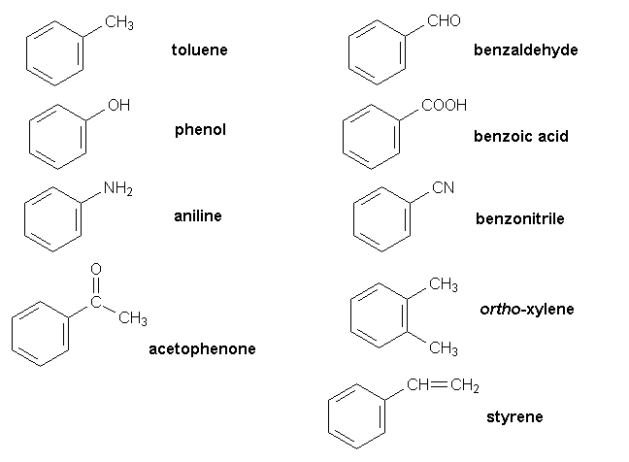
Aromatic Compounds Examples
Aromatic hydrocarbon, are hydrocarbons containing sigma bonds and delocalized pi electrons between carbon atoms in a ring. For example, benzene. They are known as aromatic due to their pleasant smell.
Aromatic Compounds Examples

Slide 4
Aromatic compounds are broadly divided into two categories: benzenoids (one containing benzene ring) and non-benzenoids (those not containing a benzene ring) for example, furan. Any hydrocarbon can be classified as an aromatic compound provided they follow the Huckel rule. According to Huckel rule, for a ring to be aromatic it should have the following properties:
Planarity
Complete delocalization of the π electrons in the ring
Presence of (4n + 2) π electrons in the ring where n is an integer (n = 0, 1, 2, . . .)

Slide 5
Huckel’s Rule of Aromaticity
Huckel’s rule states that only planar, fully conjugated monocyclic polyenes having 4n + 2 π electrons, where n is an integer, that is, n = 0, 1, 2, 3, 4, etc., should possess aromatic stability. An aromatic compound must be planar and contain a cyclic cloud of π electrons below and above the plane of the molecule. It contains SP² hybridized carbon atoms and must obey the Huckel rule.
According to this rule, the ring system must have (4n+2) π electrons, where n is any whole number (0, 1, 2, 3, etc). On this basis the ring systems which have 2(n=0), 6(n=1), 10(n=2), 14(n=3) etc pi electrons are aromatic. Typical examples of aromatic compounds are benzene, naphthalene, and anthracene.

Slide 6
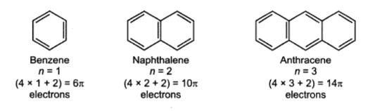
Huckel’s Rule of Aromaticity
Properties of Aromatic Compounds
Arenes are mostly nonpolar and non-miscible in water. These compounds are usually unreactive and are used as solvents for various other nonpolar compounds. Their carbon to hydrogen ratio is high therefore, they are characterized by sooty yellow flame.

